Slide 1
AI based proactive system administration
Bipin Sinha

Slide 2
Use Case: Proactive System Administration
Business Case: With the help of various trace files, how can we take deep dive into system and enable system administrator for proactive system administration to reduce unplanned outages
Solution: We can use AI to understand various traces of system and develop chatbot which will provide deeper insight of system. This will enable system admin to focused on business critical issues more and make system stable proactively even before landing into unplanned outages.
Business Benefit:
System Admin will have deeper insight about error which could lead to system outage even before it is raised by user.
System admin will be able to focus more on business critical rather on technically visible issues.
Focused approach while solving system error which will potentially reduce the overall unplanned outages of system.

Slide 3
AI Solution High-level View
We can use AI as our helper to solve this complex issue.
Since all input data is in the form of text, so we can use Text mining and Graph mining algorithms to solve these problems.
We can develop chat bot which can answer queries related to given content. Based on capacity of platform, AI can scan large numbers of document at a time and answer our queries quickly.
Stream analytics can be used to query on dynamically generated massages.

Slide 4


High Level Architecture of NLP QA system (CDQA)
Trace Files
Object Dependency
Object Severity
Knowledge Graph Creation
Question Processing
Keyword Extraction
Knowledge Graph Queries
Answer Processing
Question
Question Type Detection
Answer

Slide 5
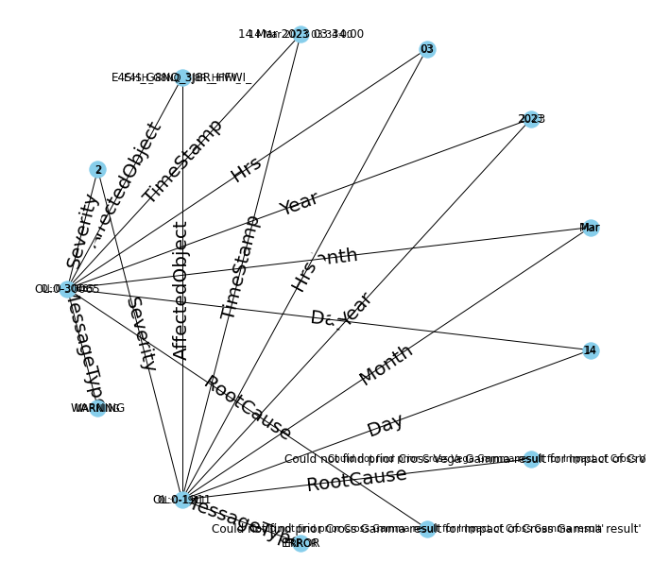
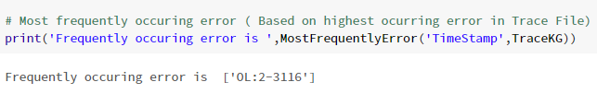
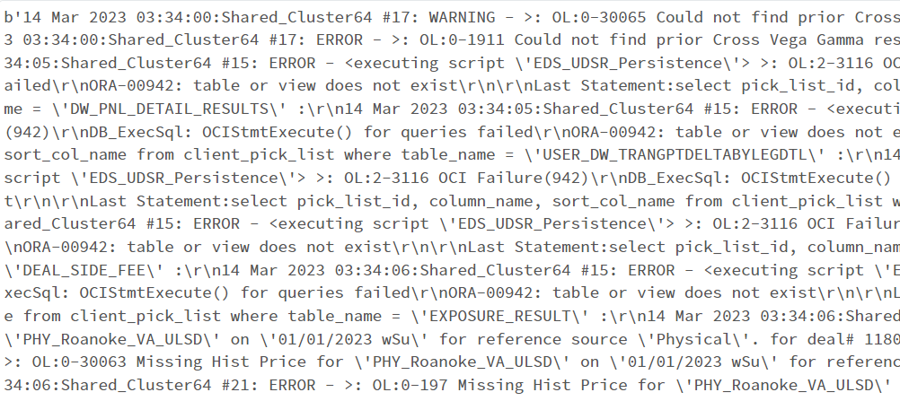

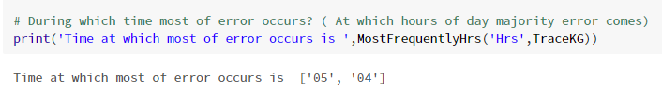
Demo
Spread of error within system

Slide 6
Questions and Answers

